Slide 1

Getting Started with Data Management
& DMPTool
<Your Name Here>
<Your Institution Here>

Slide 2
Overview
Why is data management important?
What is a data management plan?
The DMPTool

Slide 3
Overview
Why is data management important?
What is a data management plan?
The DMPTool

Slide 4
Why is Data Management Important?
Data sharing allows for reproducibility, transparency, and data re-use in research.
Sharing is easier if data are managed well from the start of a project.
Notes:
http://www.flickr.com/photos/jasonlparks/4253344038/

Slide 5






Data Management & Sharing Mandates
Journals – PLOS, Nature, JDAP partners
Funders – NSF, NIH
Office of Science & Technology Policy mandate, February 2013
Notes:
JDAP = joint data archiving policy, where journals partner with the Dryad repository

Slide 6
Overview
Why is data management important?
What is a data management plan?
The DMPTool

Slide 7
What is a data management plan?
A document that describes what you will do with your data
during your research
and after you complete your project

Slide 8
Why prepare a DMP?
Saves time
Increases research efficiency
Satisfies funder requirements
Makes reproducibility & sharing easier

Slide 9
A DMP is a Living Document
Keep your plan current
Incorporate changes
Use as a guide for daily activities
Notes:
http://www.flickr.com/photos/garymacfadyen/6860004327/
Clarify the purpose
List the impact and risks
Is this a one time shot at gathering observational data or is this an experiment that could be repeated?
Determine which sides of the triangle are flexible
If you are going on a research trip where the schedule is set (ie. research cruise), then that element is not flexible, and cost/scope may need to adjust.

Slide 10
Where to Start?
Small & Simple
Document what you know now
Share the plan with your team
Avoid procrastination and immobilization
Notes:
Document what you know now
Share the plan with your team
When getting started, simple and understandable is better than complex
Avoid procrastination and immobilization

Slide 11
Components of a Basic DMP
Types of data
Data & metadata standards
Policies
Plans for preservation
Budget
Notes:
http://www.flickr.com/photos/kmtucker/3355551036/sizes/l/

Slide 12
Types of data
Types of data produced
Relationship to existing data
How/when/where will the data be captured or created?
How will the data be processed?
Quality assurance & quality control measures
Security: version control, backing up
Who will be responsible for data management during/after project?
Notes:
Types: experimental, observational, raw or derived, physical collections, models, simulations, curriculum materials, software etc.

Slide 13
Data & metadata standards
What metadata are needed to make the data meaningful?
How will you create or capture these metadata?
Why have you chosen particular standards and approaches for metadata?

Slide 14
Policies for access, sharing, re-use
Are you under any obligation to share data?
How, when, & where will you make the data available?
What is the process for gaining access to the data?
Who owns the copyright and/or intellectual property?
Will you retain rights before opening data to wider use? How long?
Are permission restrictions necessary?
Embargo periods for political/commercial/patent reasons?
Ethical and privacy issues?
How should your data be cited?

Slide 15
Plans for archiving & preservation
What data will be preserved for the long term? For how long?
Where will data be preserved?
What data transformations need to occur before preservation?
What metadata will be submitted alongside the datasets?
Who will be responsible for preparing data for preservation?
Who will be the main contact person for the archived data?

Slide 16
Budget
Costs of data preparation & documentation
Hardware, software
Personnel
Archive fees
How costs will be paid
Request funding!
Notes:
http://dorrys.com/

Slide 17
Overview
Why is data management important?
What is a data management plan?
The DMPTool

Slide 18
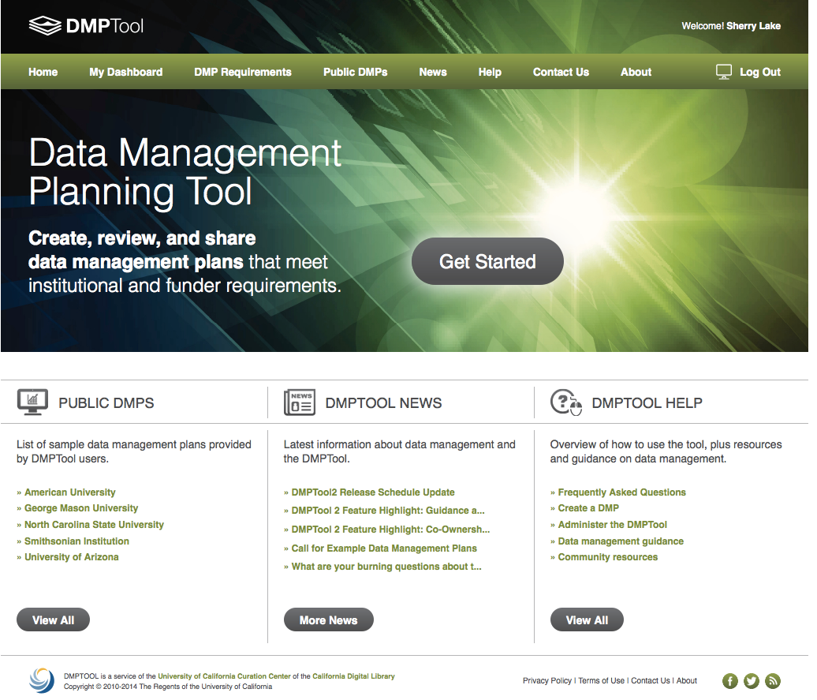
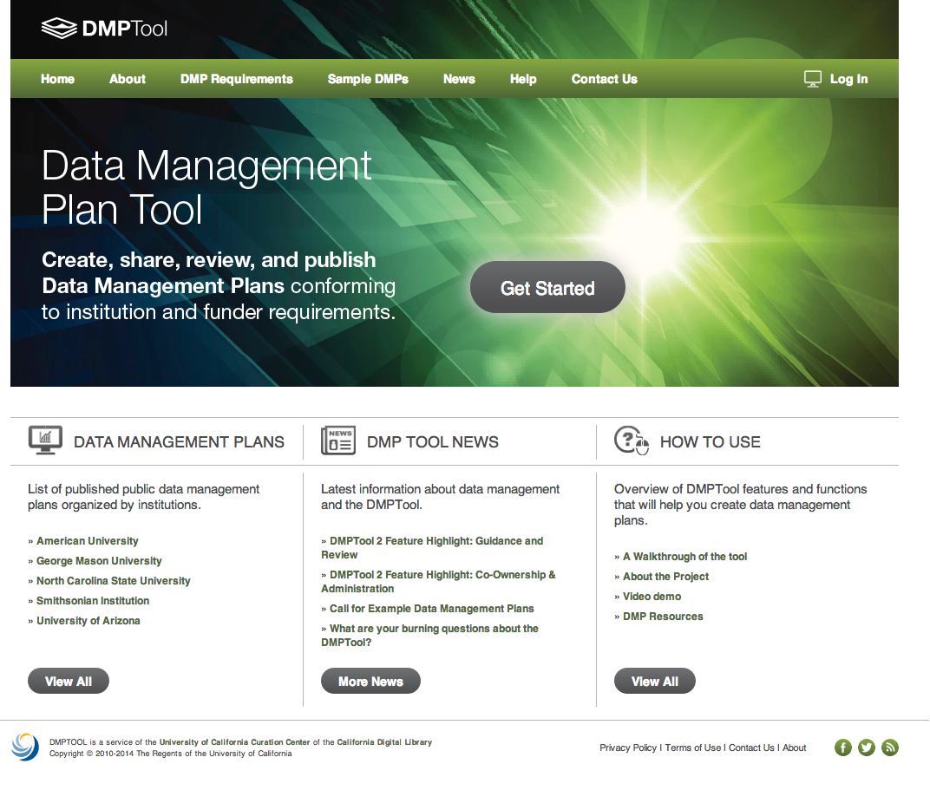

Slide 19
Funder guidance
Library of public DMPs
Data management resources

Slide 20
Log in

Slide 21
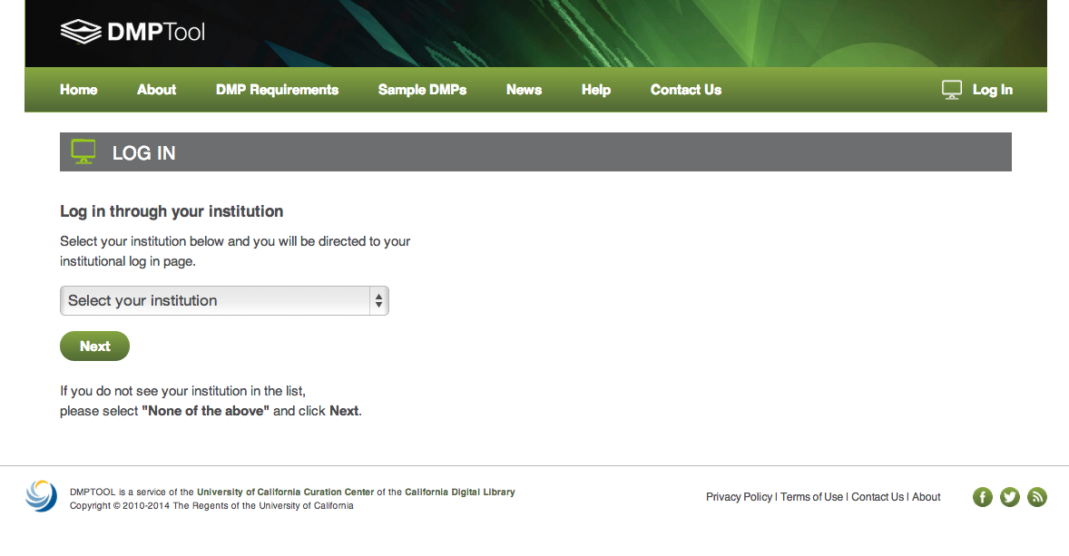
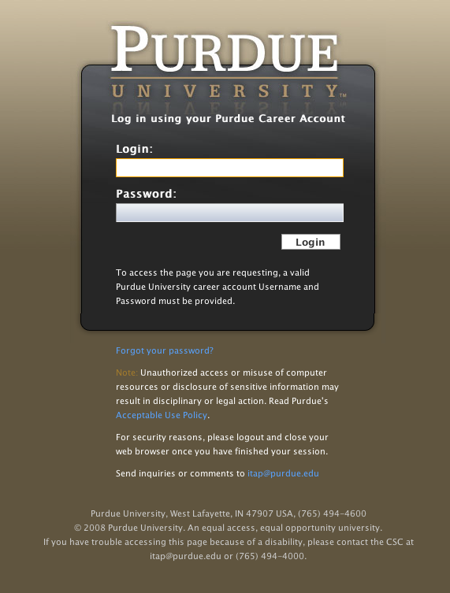
Select Institution
If your institution is a partner, you will be redirected to their login page

Slide 22
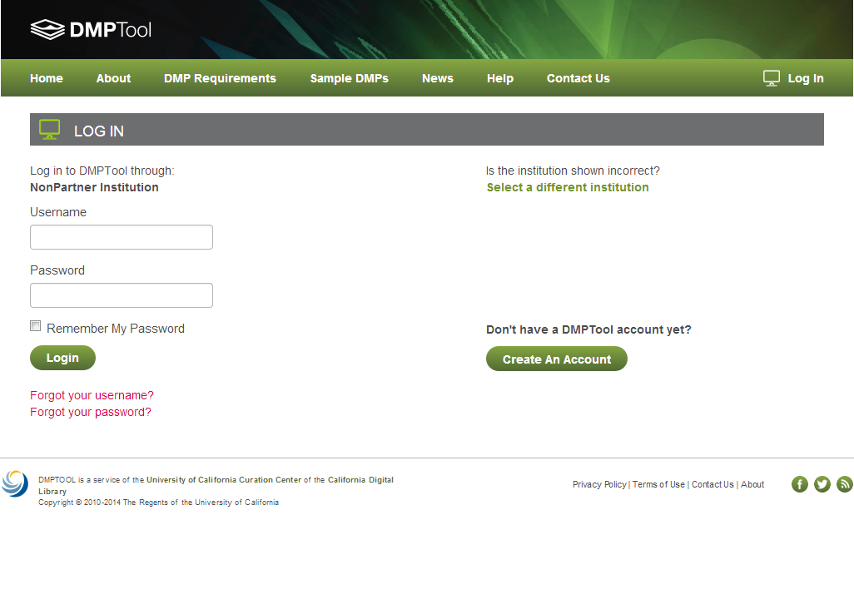
Your institution not listed?
Select “Non-partner”
Then create an account

Slide 23
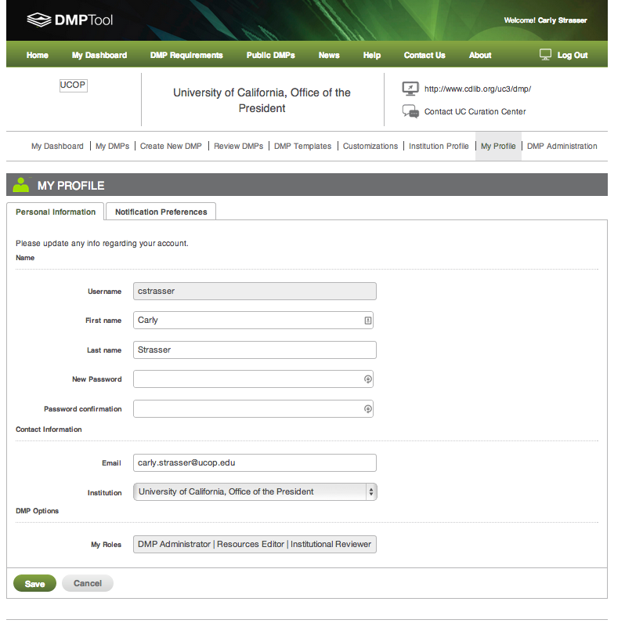

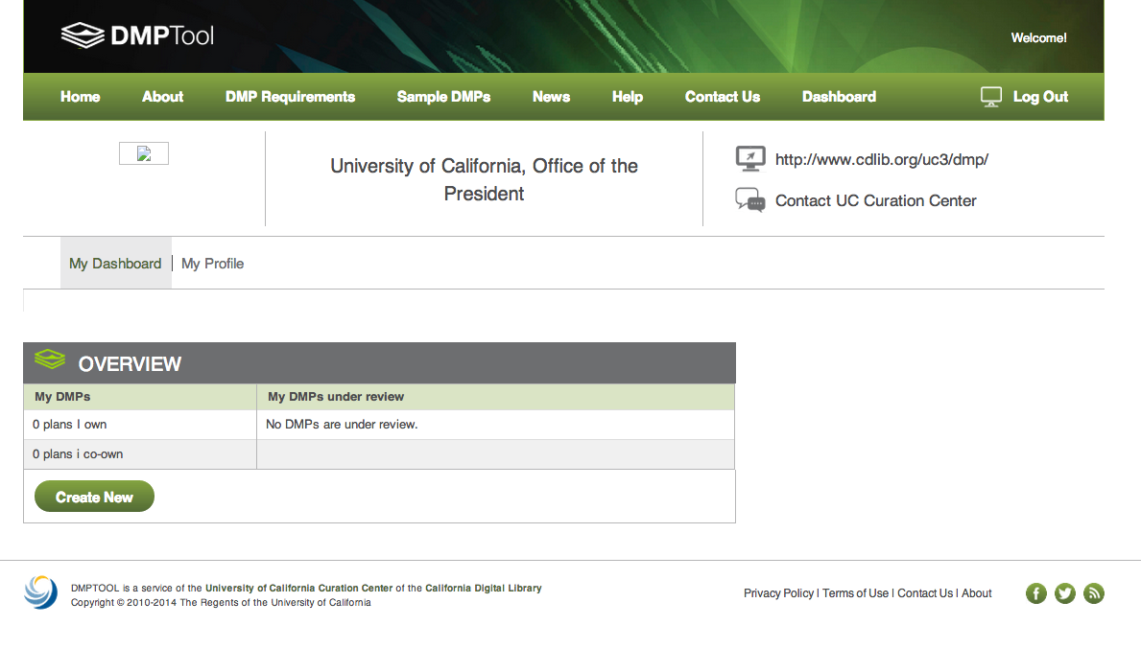
Set up your profile & notification preferences

Slide 24
Dashboard overview of DMPs
Create new DMP

Slide 25
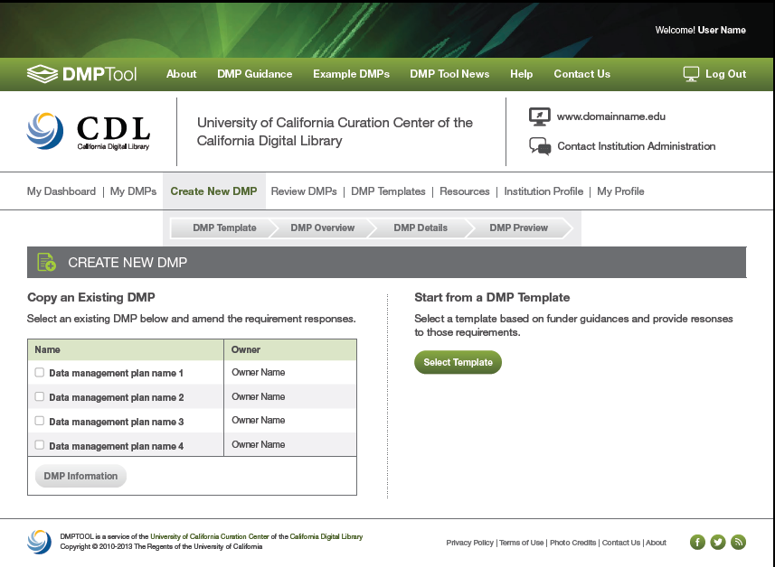
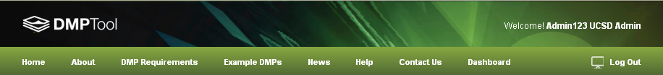
Or start a new plan
Either copy an existing DMP

Slide 26
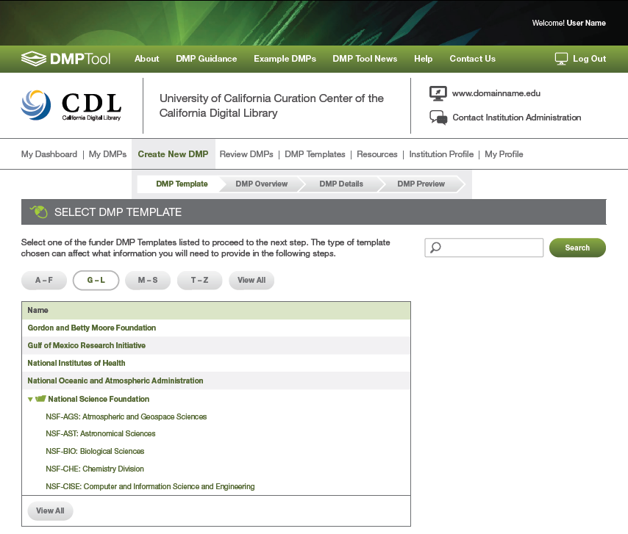
Select Funder

Slide 27
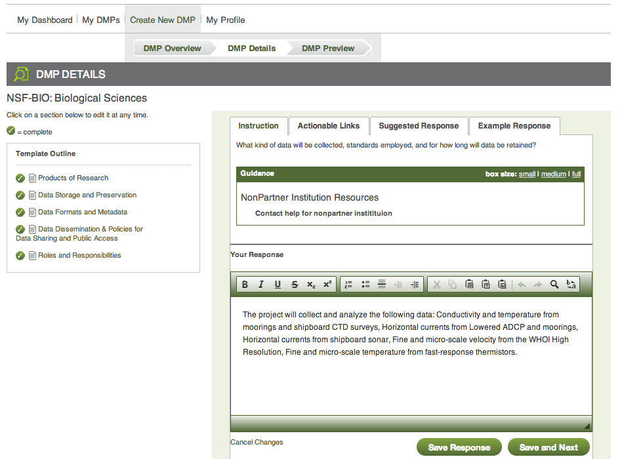
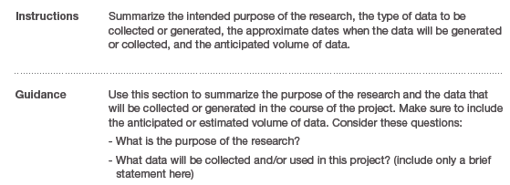
Instructions & help
Answer questions

Slide 28
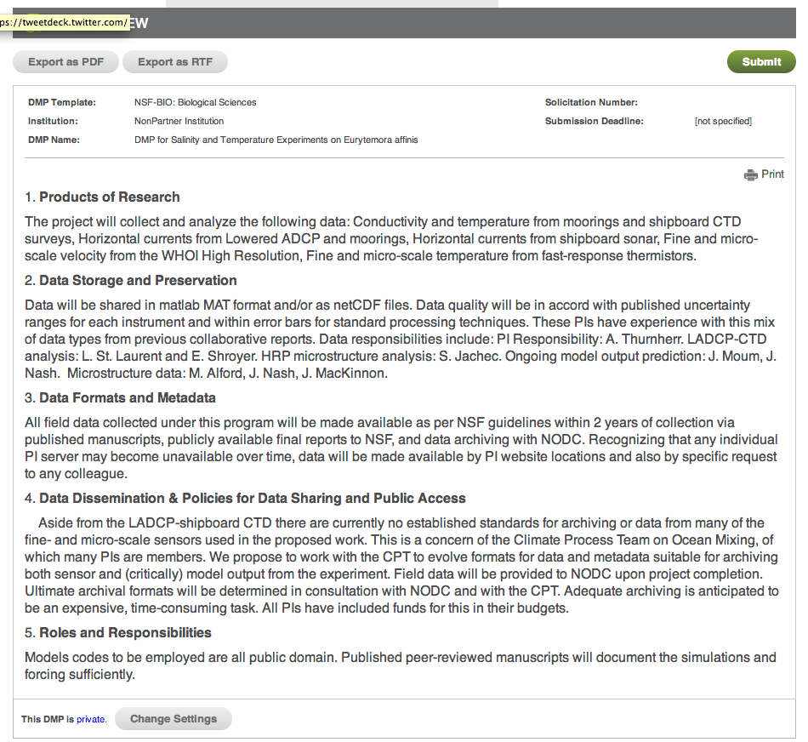
Export plan
.txt, .rtf, .pdf
Preview plan

Slide 29
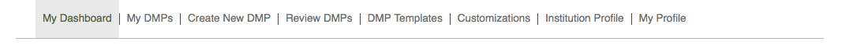
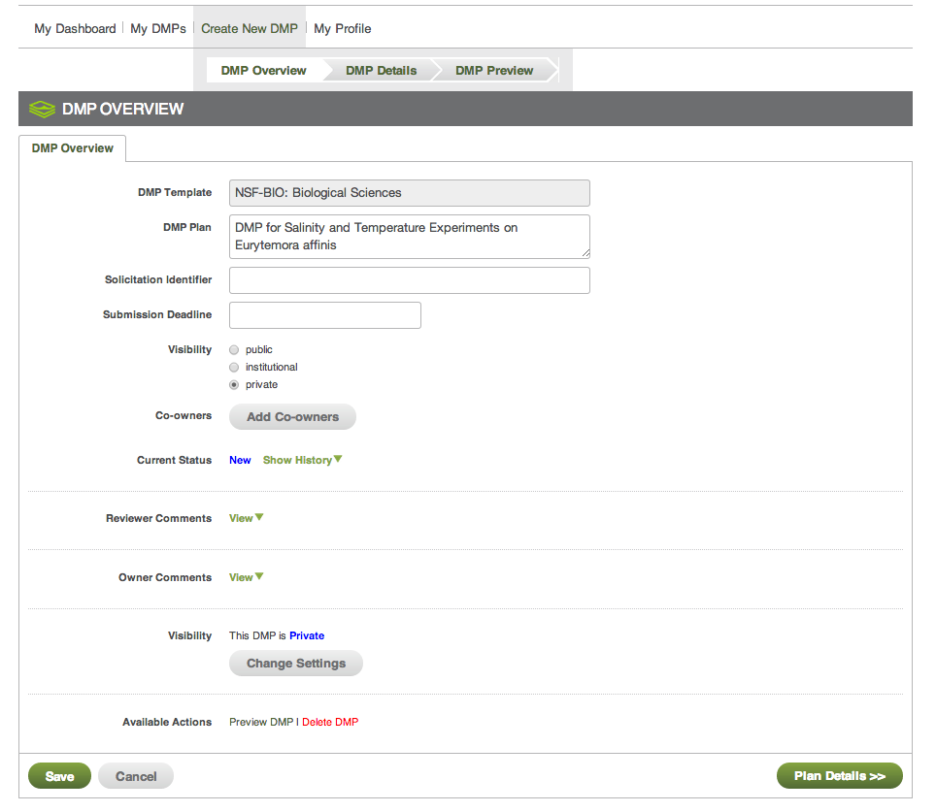
Co-owners can
Edit
Preview
Download
Add co-owners

Slide 30
Three options:
Private – owners & co-owners only
Within institution
Publicly
Visibility settings

Slide 31
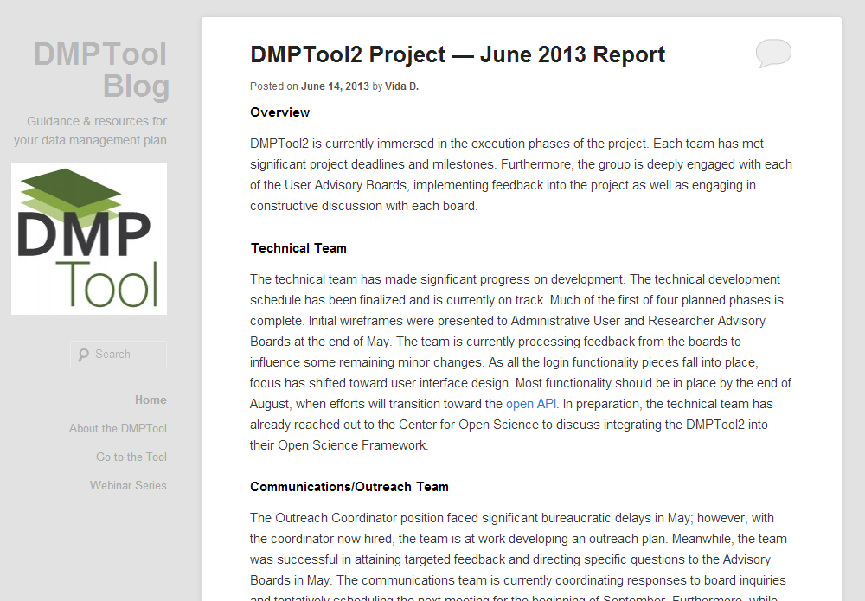
blog.dmptool.org

Slide 32
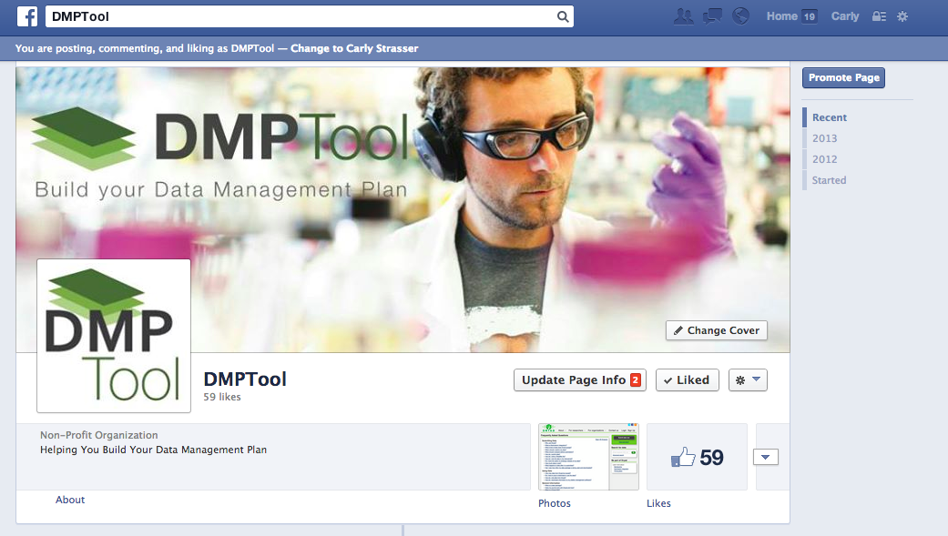
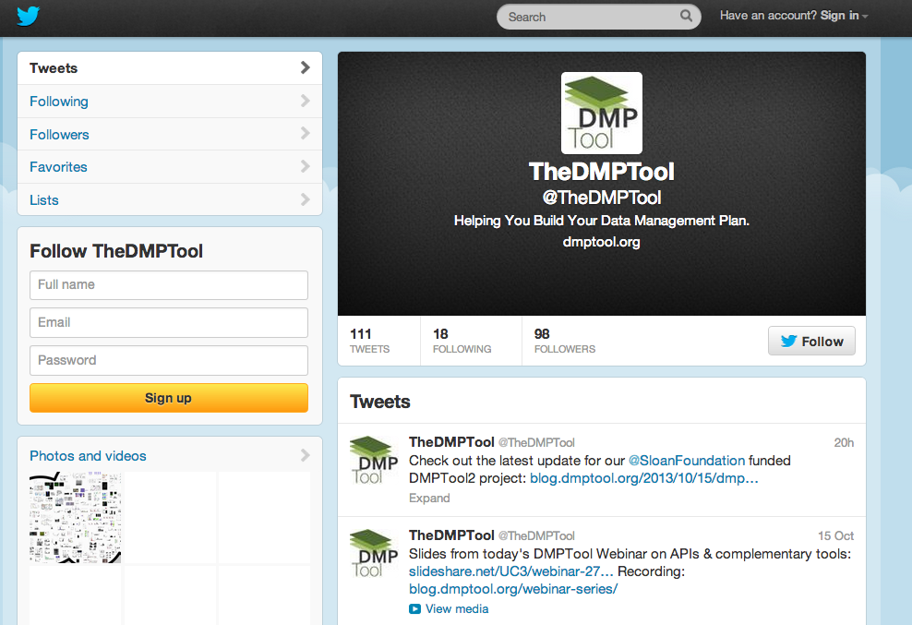
facebook.com/dmptool

Slide 33
Email
Twitter
Facebook
Blog
uc3@ucop.edu
<your email here>
@TheDMPTool
dmptool
blog.dmptool.org

